Slide 1
ATI-2173, a Novel Active Site Polymerase Inhibitor Nucleotide (ASPIN), for HBV Cure Regimens Is Well Tolerated and Has Favorable Pharmacokinetics in Healthy Volunteers
Douglas Mayers,¹ Katherine Squires,¹ Lauren Ogilvie,¹ Gaetano Morelli,² Jade Huguet,² Rebeca Melara,² Martin Constantineau,² Abel De La Rosa¹
¹Antios Therapeutics, Atlanta, GA, USA; ²Altasciences, Montreal, Quebec, Canada
HBV-TAG 2021; June 11-12, 2021; Virtual

Slide 2
The Novel ASPIN ATI-2173 Is a Potential Agent for HBV Cure
Current treatments for chronic HBV infection are not curative and require lifelong therapy to maintain viral suppression¹
Clevudine demonstrated extended posttreatment reductions in HBV viral load in phase 2 and 3 studies, but clinical development was stopped voluntarily by the sponsor when reversible skeletal muscle myopathy was observed in a small subset of subjects with clevudine exposure >8 months²⁻⁶
ATI-2173, a novel liver-targeted phosphoramidate prodrug of clevudine-5’-triphosphate that functions as an ASPIN, is in development as a potential curative agent for chronic HBV infection⁷
ATI-2173 delivers the 5’-monophosphate of clevudine directly to the liver by bypassing the first phosphorylation step, thereby reducing systemic clevudine exposure and associated toxicities⁷
Here we summarize the preclinical profile of ATI-2173 and report the safety and PK of ATI-2173 from a phase 1a study of healthy volunteers
In vitro studies of anti-HBV activity were conducted in HepG2/HepG2.2.15 cells and primary human hepatocytes
ATI-2173 PK were assessed in plasma and liver in Sprague-Dawley rats and peripheral and portal plasma in cynomolgus monkeys
The safety, tolerability, and PK of multiple ascending doses of ATI-2173 in healthy subjects were assessed in a phase 1a, randomized, double-blind, placebo-controlled trial conducted in Canada as part of the ANTT101 study (NCT04248426)
ASPIN, active site polymerase inhibitor nucleotide; HBV, hepatitis B virus; PK, pharmacokinetics.
1. Seto et al. Lancet. 2018;392:2313-2324. 2. Marcellin et al. Hepatology. 2004;40:140-148. 3. Lee et al. Hepatology. 2006;43:982-988. 4. Yoo et al. Hepatology. 2007;46:1041-1048. 5. Lim et al. Aliment Pharmacol
Ther. 2008;27:1282-1292. 6. Seok et al. Hepatology. 2009;49:2080-2086. 7. Squires et al. Antimicrob Agents Chemother. 2020;64:e00836-20.
HBV-TAG 2021; June 11-12, 2021; Virtual

Slide 3
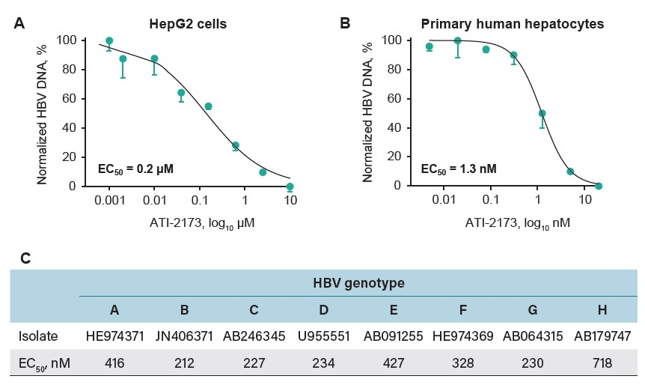
ATI-2173 Had Potent Anti-HBV Activity Across All HBV Genotypes
ATI-2173 showed potent anti-HBV activity in HepG2 cells and primary human hepatocytes as well as across all HBV genotypes
No evidence of cytotoxicity was observed within the evaluated dose range
ATI-2173 exhibited low serum protein binding, with minimal change in anti-HBV activity in the presence of increasing human serum concentrations
When combined in vitro in primary human hepatocytes, ATI-2173 showed additive antiviral activity with tenofovir, lamivudine, and the capsid inhibitor GLS4
Synergistic antiviral activity was demonstrated with adefovir, entecavir, and interferon-α
ATI-2173 displayed in vitro cross-resistance with the nucleoside analogues lamivudine and entecavir, but not with the capsid inhibitors GLS4 or AT-130
Overlapping resistance with lamivudine was observed for the reverse transcriptase mutants M204I, V173L + M204I, and L180M + M204V, but not for M204V alone
Resistance with entecavir overlapped for the reverse transcriptase mutants S202G + M204I with and without M250V
In vitro anti-HBV activity in (A) HepG2 cells, (B) primary human hepatocytes, and (C) across all HBV genotypes
EC₅₀, 50% effective concentration; HBV, hepatitis B virus.
Error bars represent standard error of the mean.
HBV-TAG 2021; June 11-12, 2021; Virtual

Slide 4
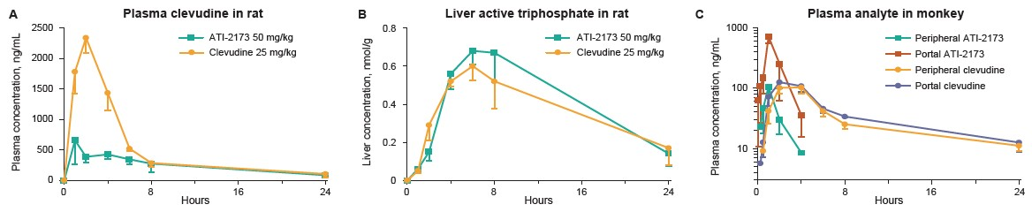
ATI-2173 Administration in Rats Demonstrated Liver Targeting and Reduced Systemic Clevudine Exposure
ATI-2173 administration in rats significantly decreased plasma clevudine exposure while maintaining similar active triphosphate concentrations in the liver compared with clevudine dosing, demonstrating liver targeting of ATI-2173
Liver targeting of ATI-2173 was also demonstrated in cynomolgus monkeys, with an 82% hepatic extraction ratio after oral ATI-2173 dosing
Mean concentrations of (A) rat plasma clevudine, (B) rat liver active triphosphate, and (C) monkey plasma ATI-2173 and clevudine
Error bars represent standard error of the mean.
HBV-TAG 2021; June 11-12, 2021; Virtual

Slide 5
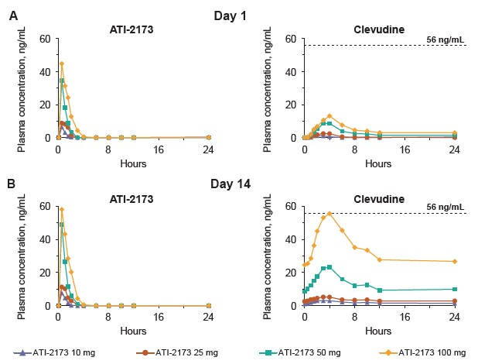
ATI-2173 Was Well Tolerated and Had Dose-Proportional PK After 14 Days of Treatment
The most common treatment-emergent AE was headache, reported in 33% of subjects (8/24) receiving ATI-2173
All AEs resolved and no serious AEs or ATI-2173 dose-limiting toxicities were reported
Following single- and repeated-dose administration, ATI-2173 was rapidly absorbed, with mean t_{max} at <1 hour post-dose and rapidly declining thereafter
ATI-2173 exposure was approximately dose proportional at the 10- and 25-mg doses and approached saturation at the 50- and 100-mg doses, with no appreciable accumulation after 14 days
Mean concentration of systemic clevudine for each ATI-2173 dose was below the minimum exposure reported for the 30-mg marketed dose of clevudine¹
Phase 1a study mean plasma ATI-2173 and clevudine
concentrations on (A) day 1 and (B) day 14
AE, adverse event; PK, pharmacokinetics; t_{max}, mean time to maximum plasma concentration.
Dashed lines represent the steady-state minimum plasma clevudine concentration observed with clevudine 30 mg in subjects with hepatitis B virus.¹
1. Lim et al. Aliment Pharmacol Ther. 2008;27:1282-1292.
HBV-TAG 2021; June 11-12, 2021; Virtual

Slide 6
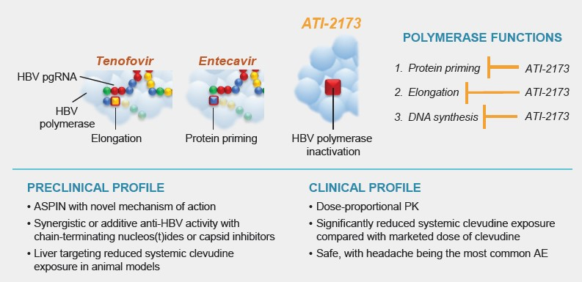
ATI-2173 Has Promising Preclinical and Clinical Profiles
The novel ASPIN ATI-2173 has promising preclinical and clinical profiles to support its development as part of a potential curative combination regimen for chronic HBV infection
ATI-2173 25- and 50-mg doses are being evaluated in combination with tenofovir in an ongoing phase 2a study in subjects with either HBV mono-infection or HBV/hepatitis D virus co-infection (NCT04847440)
Summary of ATI-2173 preclinical and clinical profiles
AE, adverse event; ASPIN, active site polymerase inhibitor nucleotide; HBV, hepatitis B virus; pgRNA, pregenomic RNA; PK, pharmacokinetics.
HBV-TAG 2021; June 11-12, 2021; Virtual

